Slide 1
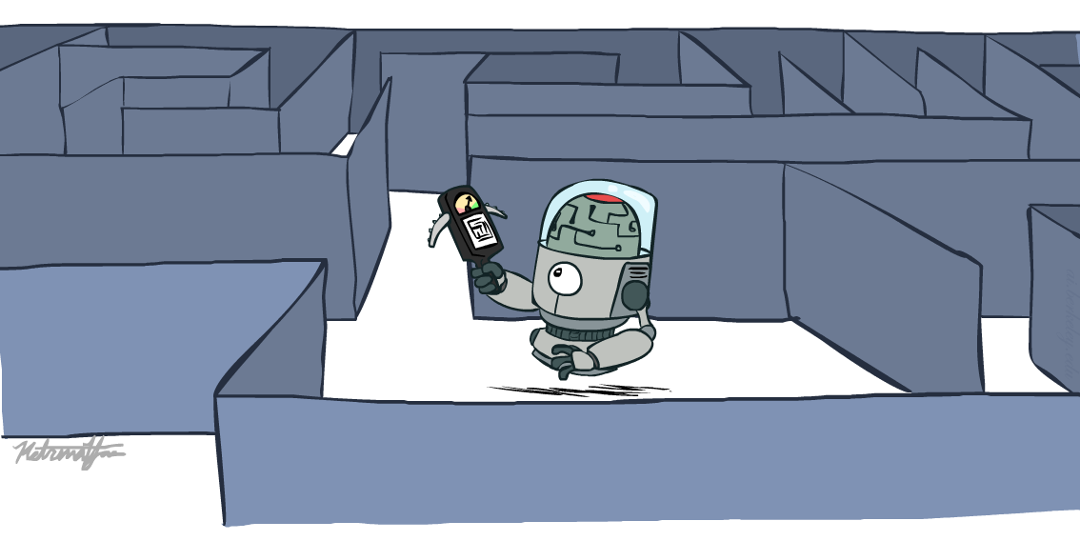
CAP 5636 – Advanced Artificial Intelligence
Informed Search
Instructor: Lotzi Bölöni
[These slides were adapted from the ones created by Dan Klein and Pieter Abbeel for CS188 Intro to AI at UC Berkeley, available at http://ai.berkeley.edu.]
Notes:
Please retain proper attribution, including the reference to ai.berkeley.edu. Thanks!

Slide 2

Today
Informed Search
Heuristics
Greedy Search
A* Search
Graph Search

Slide 3

Recap: Search

Slide 4
Recap: Search
Search problem:
States (configurations of the world)
Actions and costs
Successor function (world dynamics)
Start state and goal test
Search tree:
Nodes: represent plans for reaching states
Plans have costs (sum of action costs)
Search algorithm:
Systematically builds a search tree
Chooses an ordering of the fringe (unexplored nodes)
Optimal: finds least-cost plans

Slide 5
Example: Pancake Problem
Cost: Number of pancakes flipped
Notes:
Gates, W. and Papadimitriou, C., "Bounds for Sorting by Prefix Reversal.", Discrete Mathematics. 27, 47-57, 1979.

Slide 6
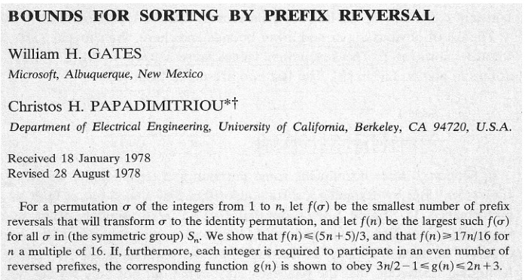
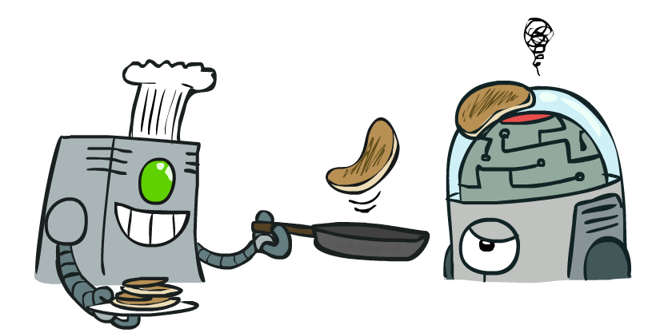
Example: Pancake Problem
Notes:
Gates, W. and Papadimitriou, C., "Bounds for Sorting by Prefix Reversal.", Discrete Mathematics. 27, 47-57, 1979.

Slide 7
Example: Pancake Problem
State space graph with costs as weights
4
2
3
2
3
4
3
4
2
3
2
2
4
3
Notes:
A* expanded 8100 ; Path cost = 33
UCS expanded 25263 . Path cost = 33
Greedy expanded 10 . Path cost = 41
[0, 7, 5, 3, 2, 1, 4, 6]
(7, 0, 5, 3, 2, 1, 4, 6)
(6, 4, 1, 2, 3, 5, 0, 7)
(3, 2, 1, 4, 6, 5, 0, 7)
(1, 2, 3, 4, 6, 5, 0, 7)
(5, 6, 4, 3, 2, 1, 0, 7)
(6, 5, 4, 3, 2, 1, 0, 7)
(0, 1, 2, 3, 4, 5, 6, 7)

Slide 8
General Tree Search
You know exactly where you came from and how you got there, but you have no idea where you’re going. But, you’ll know it when you see it.
Action: flip top two Cost: 2
Action: flip all four Cost: 4
Path to reach goal:
Flip four, flip three
Total cost: 7
Notes:
You know exactly where you came from and how you got there, but you have no idea where you’re going. But, you’ll know it when you see it.

Slide 9

Informed Search

Slide 10



Search Heuristics
A heuristic is:
A function that estimates how close a state is to a goal
Designed for a particular search problem
Examples: Manhattan distance, Euclidean distance for pathing
10
5
11.2

Slide 11
Example: Heuristic Function
h(x)

Slide 12
Example: Heuristic Function
Heuristic: the number of the largest pancake that is still out of place
3
h(x)
4
3
4
3
0
4
4
3
4
4
2
3
Notes:
A* expanded 8100 ; Path cost = 33
UCS expanded 25263 . Path cost = 33
Greedy expanded 10 . Path cost = 41
[0, 7, 5, 3, 2, 1, 4, 6]
(7, 0, 5, 3, 2, 1, 4, 6)
(6, 4, 1, 2, 3, 5, 0, 7)
(3, 2, 1, 4, 6, 5, 0, 7)
(1, 2, 3, 4, 6, 5, 0, 7)
(5, 6, 4, 3, 2, 1, 0, 7)
(6, 5, 4, 3, 2, 1, 0, 7)
(0, 1, 2, 3, 4, 5, 6, 7)

Slide 13

Greedy Search

Slide 14
Example: Heuristic Function
h(x)

Slide 15
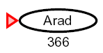

Greedy Search
Expand the node that seems closest…
What can go wrong?

Slide 16
Greedy Search
b
Strategy: expand a node that you think is closest to a goal state
Heuristic: estimate of distance to nearest goal for each state
A common case:
Best-first takes you straight to the (wrong) goal
Worst-case: like a badly-guided DFS
…
b
…
[Demo: contours greedy empty (L3D1)]
[Demo: contours greedy pacman small maze (L3D4)]
Notes:
For any search problem, you know the goal. Now, you have an idea of how far away you are from the goal.

Slide 17

Video of Demo Contours Greedy (Empty)

Slide 18
Video of Demo Contours Greedy (Pacman Small Maze)

Slide 19
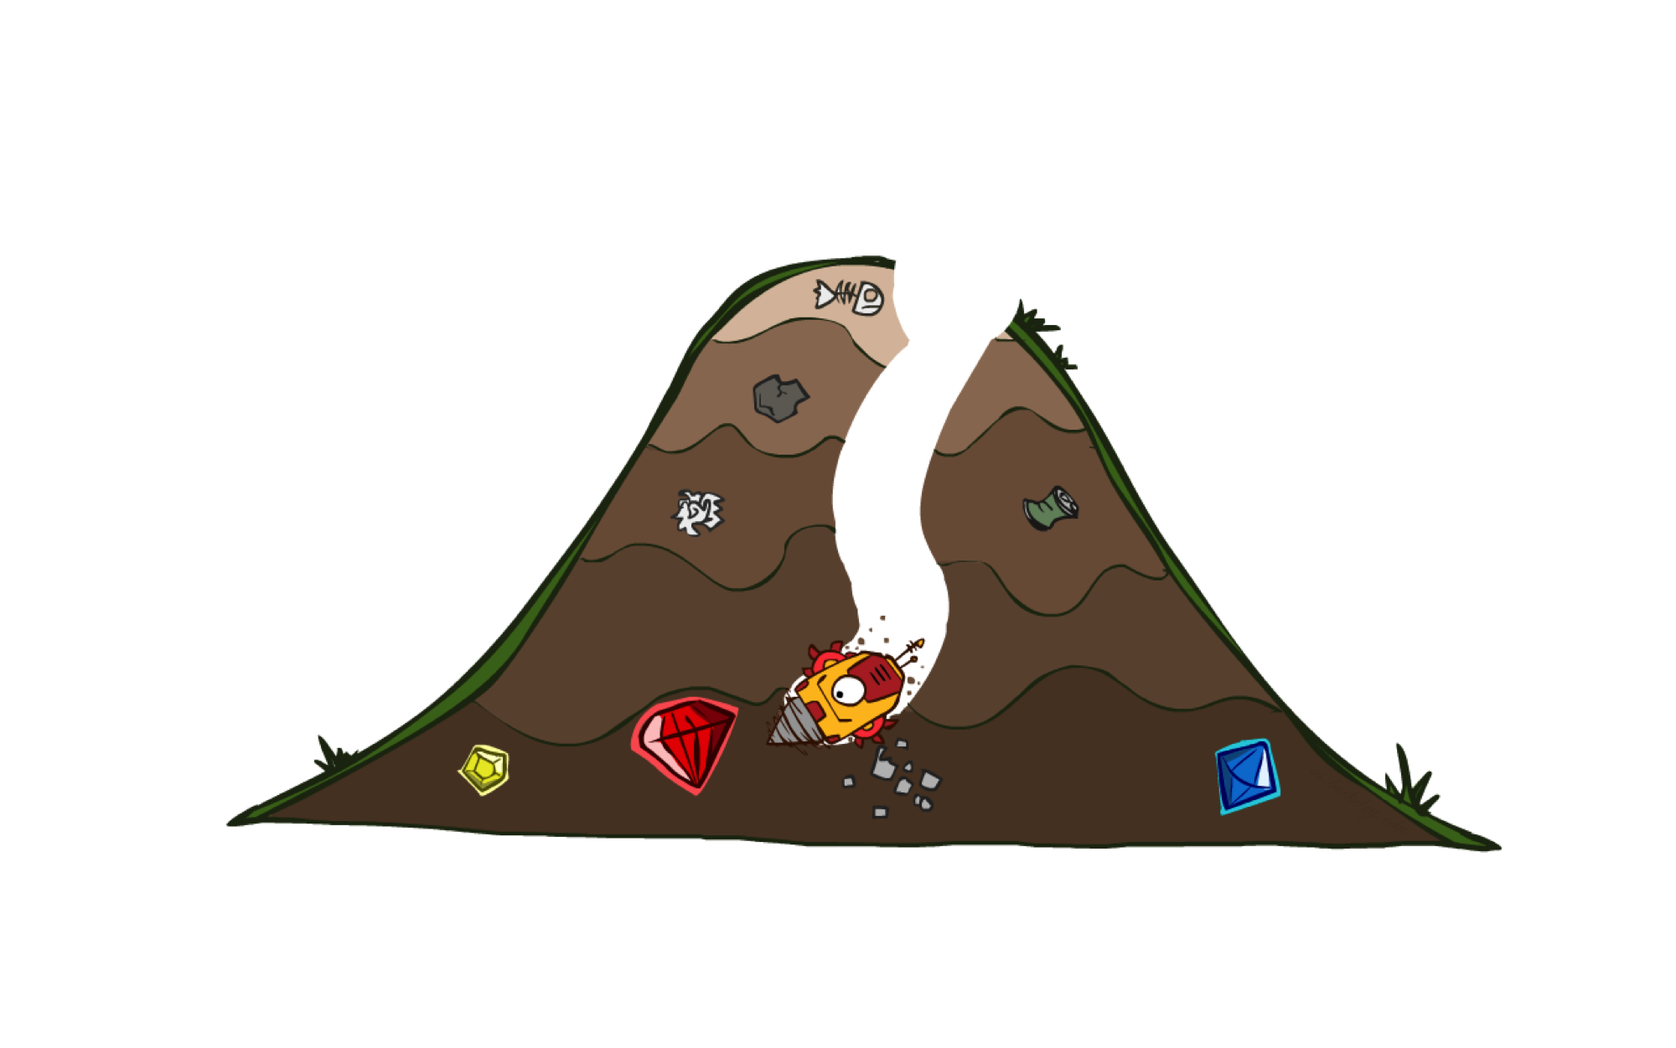
A* Search

Slide 20
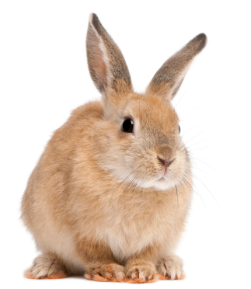
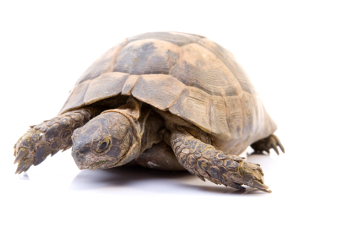

A* Search
UCS
Greedy
A*
Notes:
Notes: these images licensed from iStockphoto for UC Berkeley use.

Slide 21
Combining UCS and Greedy
Uniform-cost orders by path cost, or backward cost g(n)
Greedy orders by goal proximity, or forward cost h(n)
A* Search orders by the sum: f(n) = g(n) + h(n)
8
g = 0 h=6
S
e
h=1
g = 1 h=5
a
1
1
3
2
g = 2 h=6
g = 9 h=1
S
a
d
G
b
d
g = 4 h=2
e
h=6
1
h=5
h=2
h=0
1
g = 3 h=7
g = 6 h=0
g = 10 h=2
c
b
c
G
d
h=7
h=6
g = 12 h=0
G
Example: Teg Grenager

Slide 22
When should A* terminate?
Should we stop when we enqueue a goal?
No: only stop when we dequeue a goal
h = 2
A
2
2
S
h = 3
h = 0
G
2
B
3
h = 1

Slide 23
Is A* Optimal?
h = 6
1
A
3
S
h = 7
G
h = 0
5
What went wrong?
Actual bad goal cost < estimated good goal cost
We need estimates to be less than actual costs!
Notes:
Enqueue S(0+7)
Take out S, Enqueue G(5+0), A(1+6)
Dequeue G(5+0) -→ Solution S→ G, it is the wrong solution!!!

Slide 24

Admissible Heuristics

Slide 25

Idea: Admissibility
Inadmissible (pessimistic) heuristics break optimality by trapping good plans on the fringe
Admissible (optimistic) heuristics slow down bad plans but never outweigh true costs

Slide 26
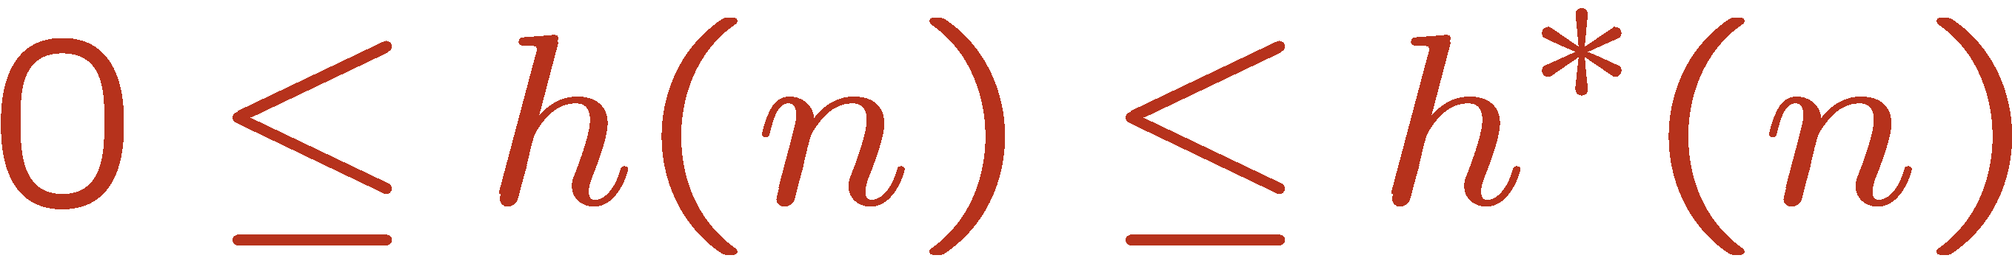

Admissible Heuristics
A heuristic h is admissible (optimistic) if:
where is the true cost to a nearest goal
Examples:
Coming up with admissible heuristics is most of what’s involved in using A* in practice.
4
15

Slide 27
Properties of A*

Slide 28
Properties of A*
Uniform-Cost
A*
b
b
…
…

Slide 29
UCS vs A* Contours
Uniform-cost expands equally in all “directions”
A* expands mainly toward the goal, but does hedge its bets to ensure optimality
Start
Goal
Start
Goal
[Demo: contours UCS / greedy / A* empty (L3D1)]
[Demo: contours A* pacman small maze (L3D5)]

Slide 30
Video of Demo Contours (Empty) -- UCS

Slide 31
Video of Demo Contours (Empty) -- Greedy

Slide 32
Video of Demo Contours (Empty) – A*

Slide 33
Video of Demo Contours (Pacman Small Maze) – A*

Slide 34



Comparison
Greedy
Uniform Cost
A*

Slide 35
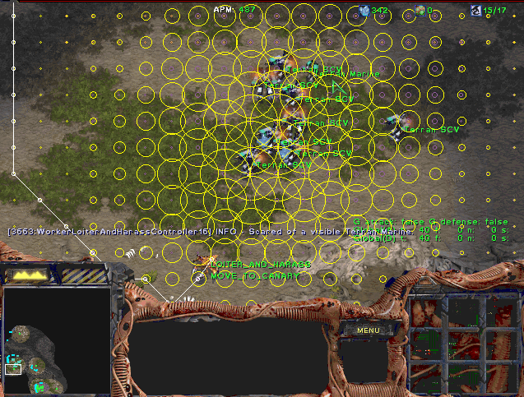
A* Applications

Slide 36
A* Applications
Video games
Pathing / routing problems
Resource planning problems
Robot motion planning
Language analysis
Machine translation
Speech recognition
…
[Demo: UCS / A* pacman tiny maze (L3D6,L3D7)]
[Demo: guess algorithm Empty Shallow/Deep (L3D8)]

Slide 37
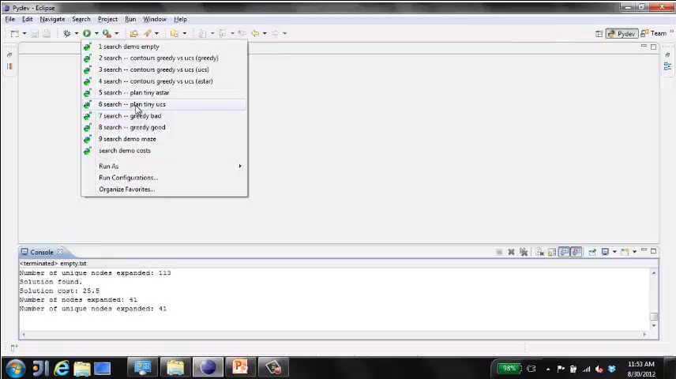
Video of Demo Pacman (Tiny Maze) – UCS / A*

Slide 38
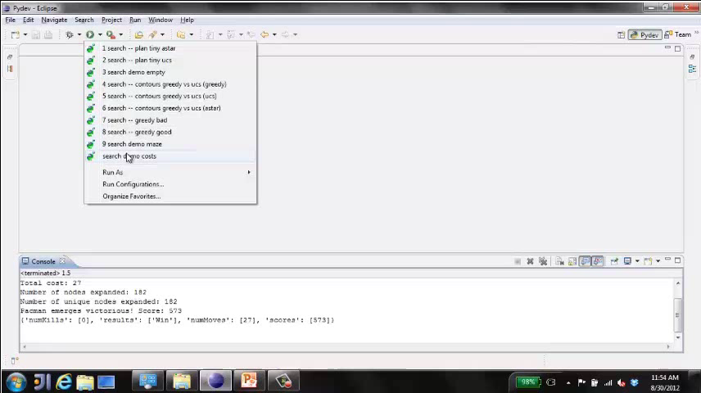
Video of Demo Empty Water Shallow/Deep – Guess Algorithm

Slide 39
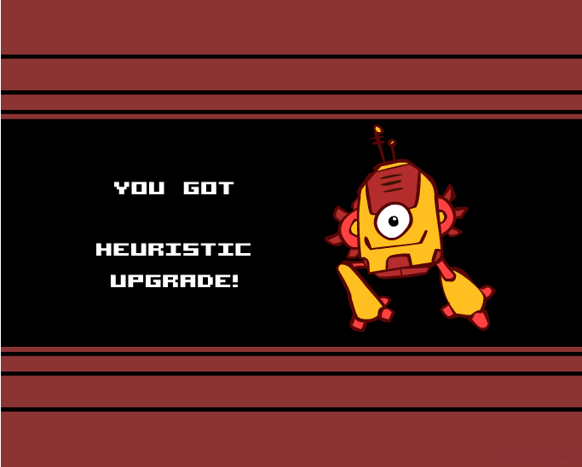
Creating Heuristics

Slide 40
Creating Admissible Heuristics
Most of the work in solving hard search problems optimally is in coming up with admissible heuristics
Often, admissible heuristics are solutions to relaxed problems, where new actions are available
Inadmissible heuristics are often useful too
366
15

Slide 41

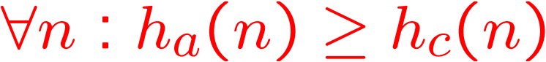
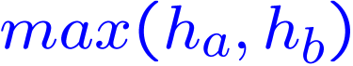

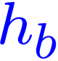
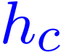

Trivial Heuristics, Dominance
Dominance: h_{a} ≥ h_{c} if
Heuristics form a semi-lattice:
Max of admissible heuristics is admissible
Trivial heuristics
Bottom of lattice is the zero heuristic (what does this give us?)
Top of lattice is the exact heuristic
Notes:
Semi-lattice: x <= y <-> x = x ^ y

Slide 42
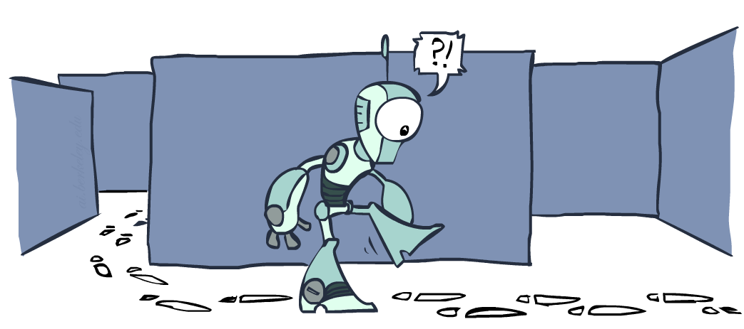
Graph Search

Slide 43
Tree Search: Extra Work!
Failure to detect repeated states can cause exponentially more work.
State Graph
Search Tree

Slide 44
Graph Search
In BFS, for example, we shouldn’t bother expanding the circled nodes (why?)
S
d
e
p
b
c
e
h
r
q
a
a
h
r
p
q
f
p
q
f
q
c
G
q
c
G
a
a

Slide 45
Graph Search
Idea: never expand a state twice
How to implement:
Tree search + set of expanded states (“closed set”)
Expand the search tree node-by-node, but…
Before expanding a node, check to make sure its state has never been expanded before
If not new, skip it, if new add to closed set
Important: store the closed set as a set, not a list
Use hashmap style lookup!
Can graph search wreck completeness? Why/why not?
How about optimality?

Slide 46
A* Graph Search Gone Wrong?
State space graph
Search tree
A
S (0+2)
1
S
1
C
h=4
h=1
A (1+4)
B (1+1)
h=2
1
2
B
3
C (2+1)
C (3+1)
h=1
G
G (5+0)
G (6+0)
h=0

Slide 47
Consistency of Heuristics
Main idea: estimated heuristic costs ≤ actual costs
Admissibility: heuristic cost ≤ actual cost to goal
h(A) ≤ actual cost from A to G
Consistency: heuristic “arc” cost ≤ actual cost for each arc
h(A) – h(C) ≤ cost(A to C)
Consequences of consistency:
The f value along a path never decreases
h(A) ≤ cost(A to C) + h(C)
A* graph search is optimal
A
1
C
h=4
h=1
h=2
3
G

Slide 48

Optimality of A* Graph Search

Slide 49
Optimality of A* Graph Search
Sketch: consider what A* does with a consistent heuristic:
Fact 1: In tree search, A* expands nodes in increasing total f value (f-contours)
Fact 2: For every state s, nodes that reach s optimally are expanded before nodes that reach s suboptimally
Result: A* graph search is optimal
…
f ≤ 1
f ≤ 2
f ≤ 3

